Slide 1
Second Part/Chapter of the Autonomic Nervous System (ANS) Pharmacology
Introductory Pharmacology PHAR2001
Dr. Ken Wojcikowski

Slide 2
Objectives for second chapter on the ANS drugs
Describe the actions, interactions and side effects of the following adrenergic agonists:
  Adrenaline (non-selective agonist)
  Phenylephrine (an alpha 1 selective agonist)
  Dobutamine (a beta 1 adrenergic agonist)
  Salbutamol (a beta 2 adrenergic agonist)
  Dopamine
  These medications will be taken again at a later time. It is most important right now to understand why the actions and side effects occur

Slide 3
Autonomic Nervous System Pharmacology
Sympathomimetics (Drugs that mimic the sympathetic nervous system (SNS)
Lesson 1:
Understanding Anaphylaxis and the Role of Adrenaline
Introductory Pharmacology PHAR2001
Dr Ken Wojcikowski

Slide 4
Sympathomimetic drugs
Sympathomimetics
Adrenergic agonists
Alpha agonist
Beta agonist
Adrenergic receptor stimulators
These terms are often used interchangeably and therefore should all be known as drugs that increase the sympathetic response

Slide 5
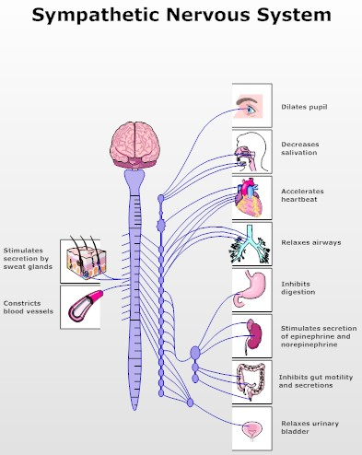

From: Daily Mail.Co UK
Contraction of urinary sphincters

Slide 6
Non-selective sympathomimetic
Specific drugs:
  Adrenaline (know this drug)
  Noradrenaline
  Metaraminol
  Ephedrine
  Dopamine (know this drug)
  Pseudoephedrine (Know; combined with antihistamines and analgesics)
These have limited use due to their effect on a wide range of organs, but are still used for treatment of hypotension and anaphylactic shock.
  After intravenous administration of adrenaline, an Alpha-adrenergic antagonist should be administered locally to offset the vasoconstricting effects of adrenaline.

Slide 7
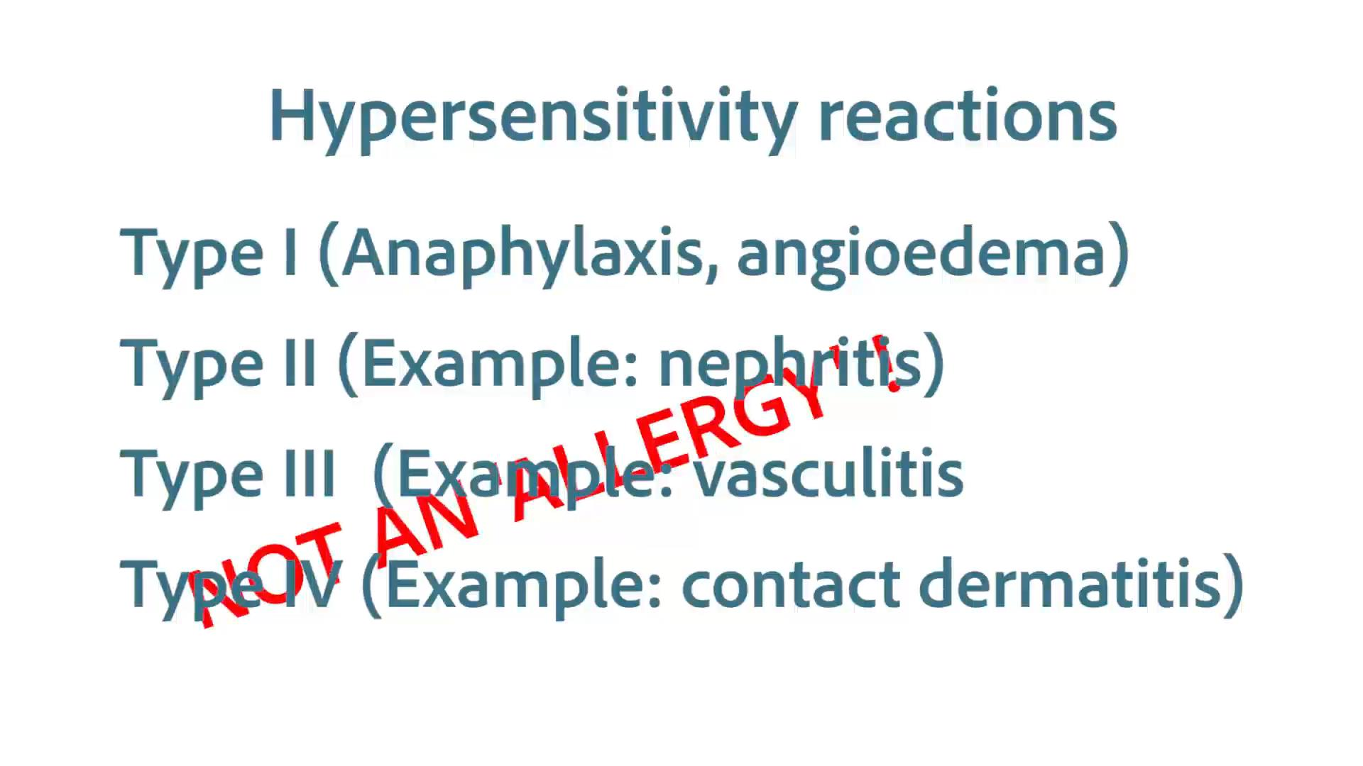
Only a Type I hypersensitivity reaction is a true allergy!

Slide 8
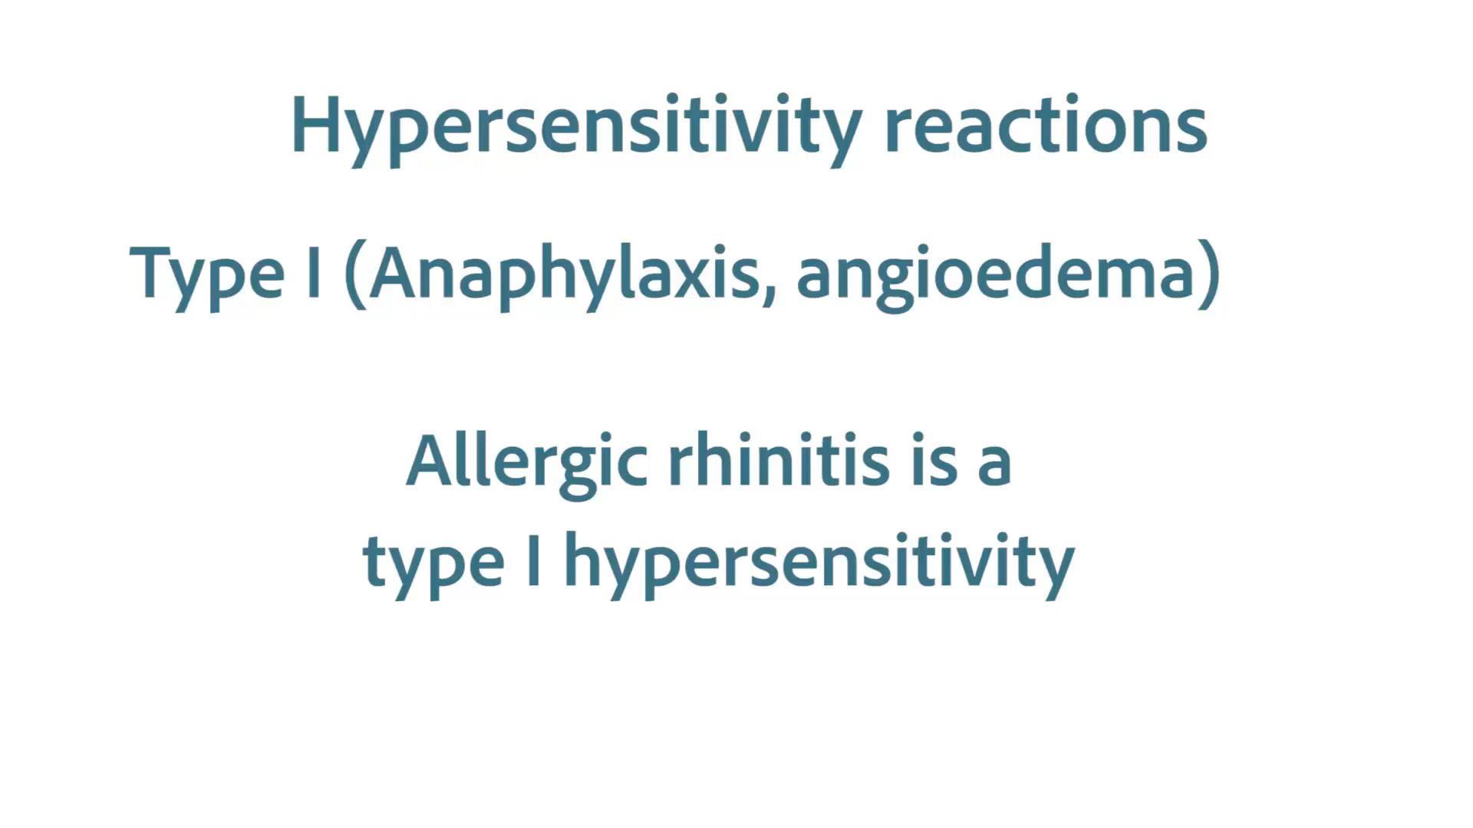

Slide 9
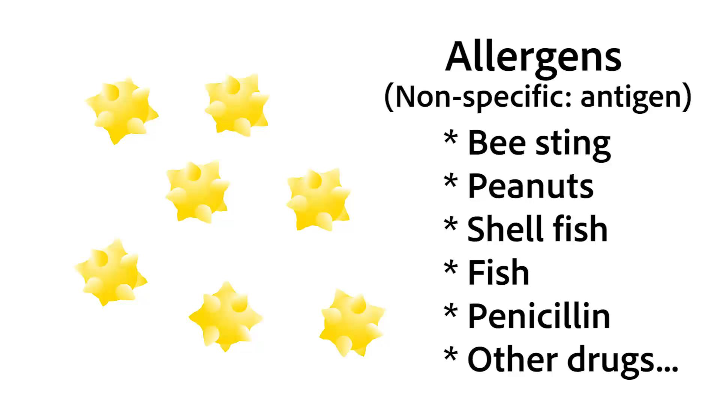

Slide 10
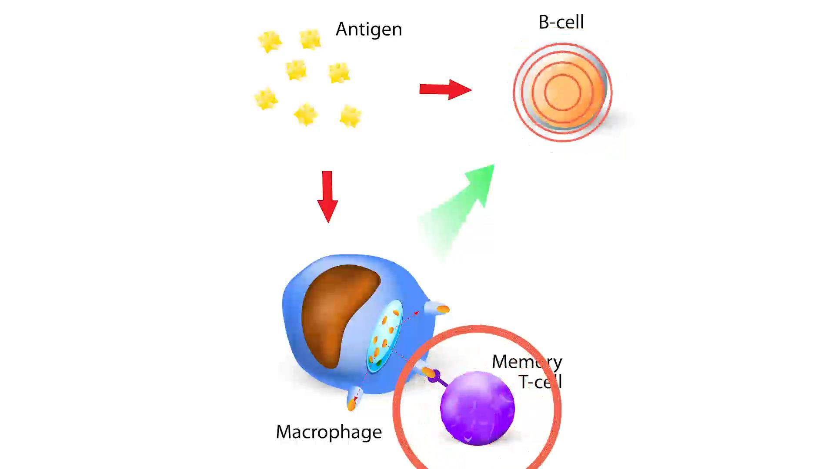

Slide 11
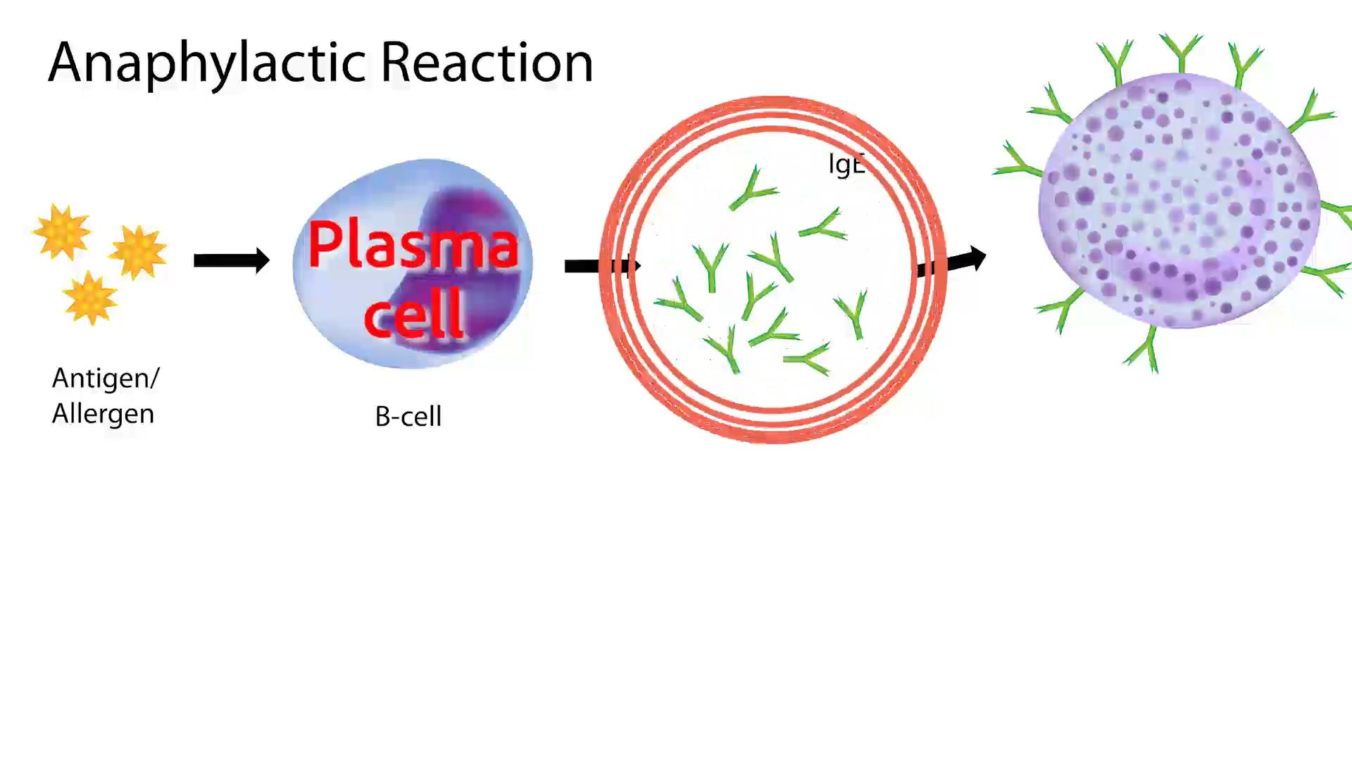

Slide 12
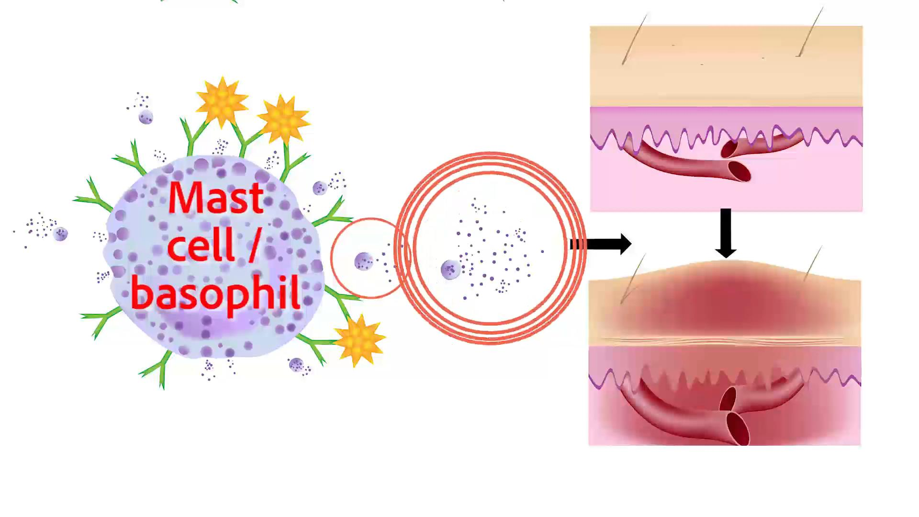

Slide 13
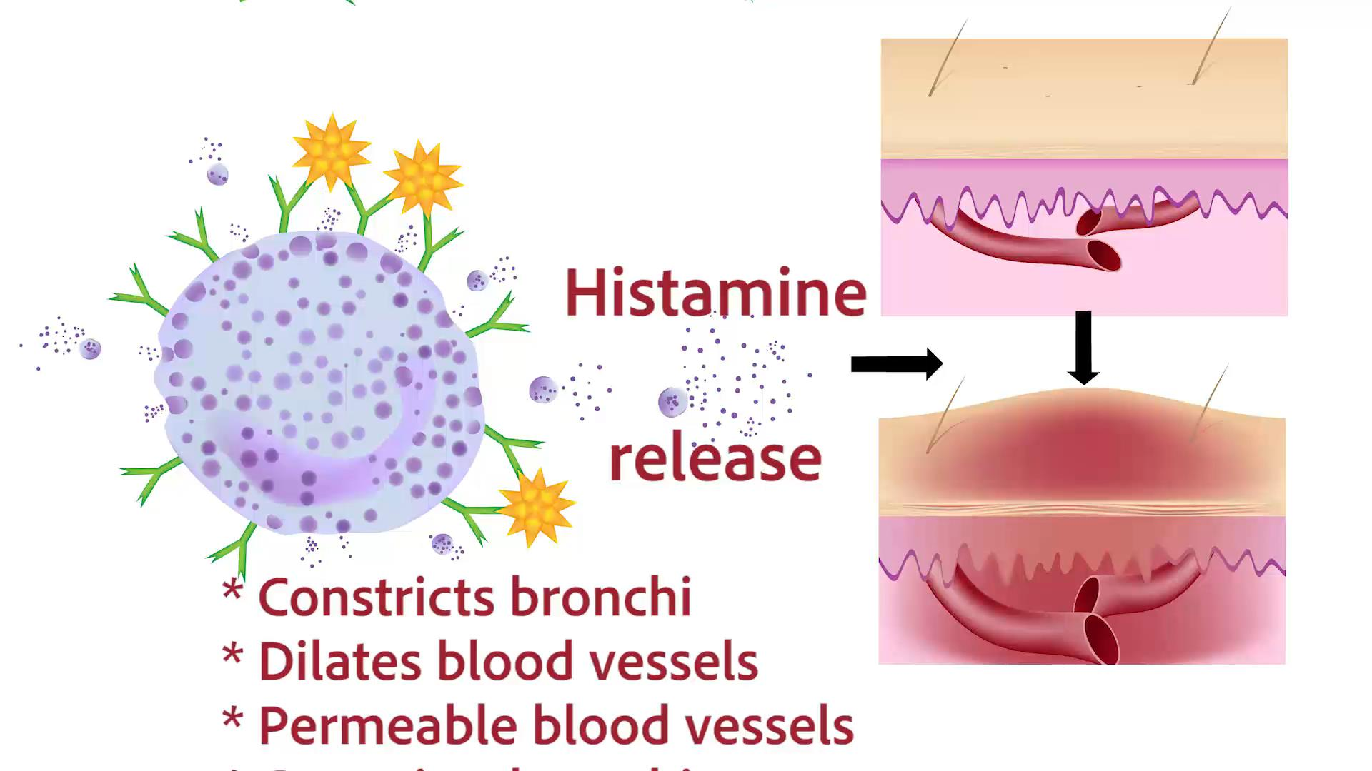

Slide 14
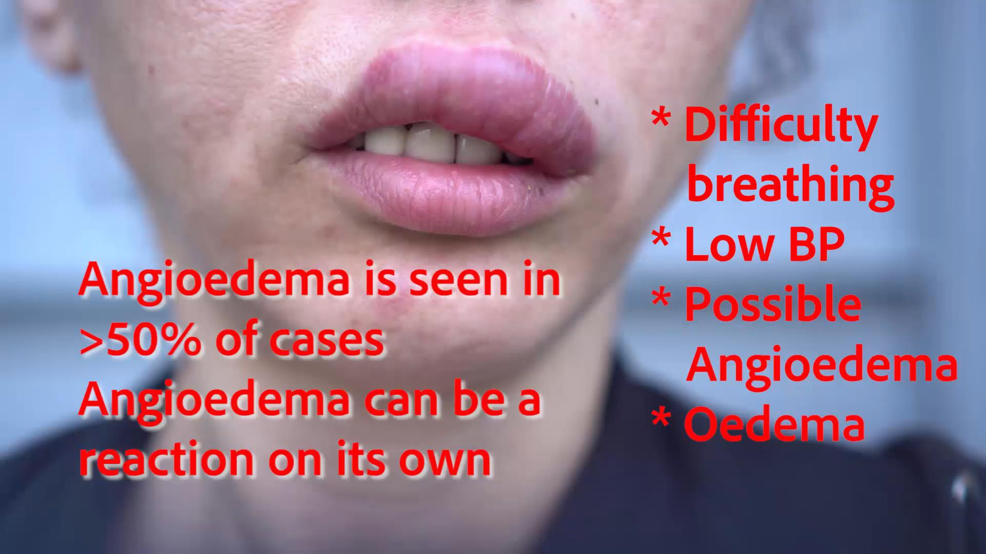

Slide 15


Slide 16
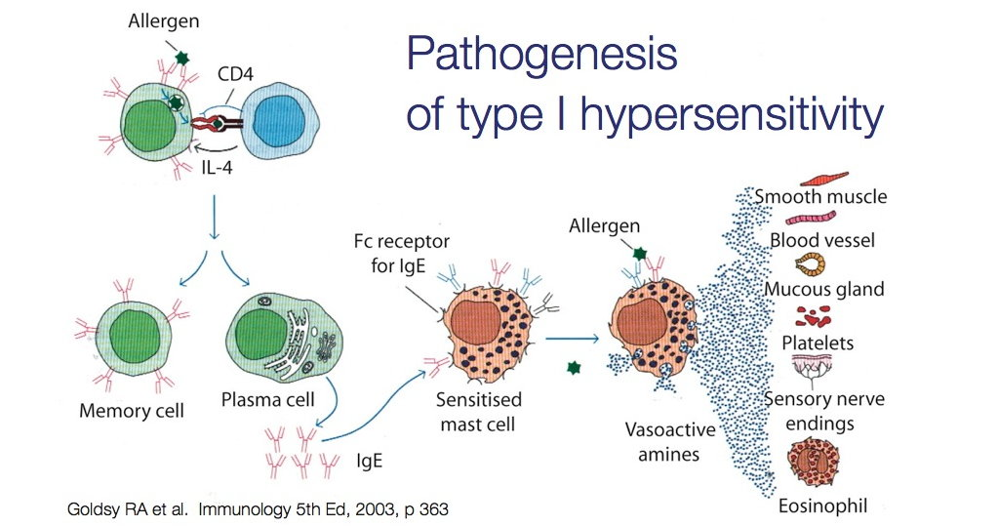
Anaphylaxis (Anaphylactic shock)

Slide 17
Autonomic Nervous System Pharmacology
Sympathomimetics
Lesson 2:
Non-selective adrenergic agonists other than adrenaline
Introductory Pharmacology PHAR2001
Dr Ken Wojcikowski

Slide 18
Non-selective sympathomimetic
Specific drugs:
  Adrenaline (know this drug)
  Noradrenaline
  Metaraminol
  Ephedrine
  Dopamine (know this drug)
  Pseudoephedrine (Know; combined with antihistamines and analgesics)
These have limited use due to their effect on a wide range of organs, but are still used for treatment of hypotension and anaphylactic shock.
  After intravenous administration of adrenaline, an Alpha-adrenergic antagonist should be administered locally to offset the vasoconstricting effects of adrenaline.

Slide 19
‘Selective’ adrenergic receptor stimulation
Subtypes of adrenergic receptors
Alpha
  Alpha 1
  Alpha 2
Beta
  Beta 1
  Beta2
While drugs that target these ‘selective’ receptors have more selectivity, they still result in some stimulation to the other receptors, especially in high doses.

Slide 20
Autonomic Nervous System Pharmacology
Sympathomimetics
Lesson 3:
Selective alpha adrenergic agonists
Introductory Pharmacology PHAR2001
Dr Ken Wojcikowski

Slide 21
‘Selective’ adrenergic receptor stimulation
Subtypes of adrenergic receptors
Alpha
  Alpha 1
  Alpha 2
Beta
  Beta 1
  Beta2
While drugs that target these ‘selective’ receptors have more selectivity, they still result in some stimulation to the other receptors, especially in high doses.

Slide 22
Alpha 1 receptors
Location of receptors:
  ‘Peripheral’ blood vessels (including those in the nasal passages; large muscles do not have this constriction to ensure they get enough blood to move quickly)
  Smooth muscles of the GIT (less effect than Beta 1 stimulation)
  Sphincters of the bladder
  Radial muscles of the eye
Given the location of the receptors, hypothesise the uses and side effects of Alpha 1 sympathomimetics

Slide 23
Alpha 1 agonists: side effects
Any sympathetic nervous system actions can be increased, but the most common adverse effects include:
  Hypertension
  Constipation
  Urinary retention
  (eye pain is possible)

Slide 24
Actions: Alpha 1 agonists
Nasal passages and eyes:
  The constrictive effects of Alpha 1 adrenergic agonists can counteract the vasodilation that leads to nasal congestion and the ‘red eye’.
Systemically:
  Increase in blood pressure (through a constriction of blood vessels).
Dilate the pupils
  Allows as much light in as possible but can also lead to eye pain when too much light is being allowed in.
In minor surgery
  Local administration constricts blood vessels for less bleeding and decreased systemic absorption of local anaesthesia

Slide 25
Alpha 1 agonists
(Most end in -ine, like epinephrine but that is not a formal suffix)
Phenylephrine (know this one; used primarily as a decongestant, as an agent to dilate the pupils, and to increase blood pressure. )
Midodrine (oral decongestant)
Naphazoline (intranasal decongestant)
Oxymetazoline (know this drug; intranasal decongestant)
Xylometazoline (intranasal decongestant)

Slide 26
Alpha 2 agonists
This is the exception to the rule so ignore for now.
Explanation: the Alpha 2 receptor exists to make sure that the adrenaline response does not result in so much stimulation that it can do harm. It is a ‘negative feedback’ type of receptor and does exactly opposite to that which one would expect.

Slide 27
Autonomic Nervous System Pharmacology
Sympathomimetics
Lesson 4:
Selective beta adrenergic agonists
Introductory Pharmacology PHAR2001
Dr Ken Wojcikowski

Slide 28
Beta 1 adrenergic receptors
Location
  Heart
  Git
  Kidneys
Given the location of the receptors, hypothesise the uses and side effects of Beta 1 agonists (selective Beta 1 sympathomimetics)

Slide 29
Actions: Beta 1 adrenergic agonists
Positive chronotropic effects (increased heart rate)
Positive inotropic effect (increase in the contractile force of the heart)
  Know these terms – chrono=time (beats/min) inos=fibre (how much stretch
Therefore these drugs are useful in circulatory shock, hypotension and cardiac arrest
Adverse effects
  GIT – constipation
  Kidneys – decreased blood flow = increased systemic blood pressure via the renin angiotensin aldosterone mechanism
Example: Dobutamine (know this drug; used to treat acute but potentially reversible heart failure)

Slide 30
Beta 2 receptors
Location
  Lung
  Mast cells
  Skeletal muscle
Given the location of the receptors, hypothesise the uses and side effects of Beta 2 agonists (selective Beta 2 sympathomimetics)

Slide 31
Actions: Beta 2 agonists
Bronchodilation
Mast cell stabilisation
(Side effect: often associated with muscle tremor)
Used in chronic obstructive pulmonary disease, acute asthma and premature labour
Eformoterol, indacaterol, salmeterol
Salbutamol (know this drug; used for the relief of bronchospasm in conditions such as asthma and COPD

Slide 32
References
Goldsy RA et Al. Immunology 5th ed. WH Freeman Publishers, 2003
Marieb E. Human Anatomy and Physiology, 5th ed. Benjamin Cummings, San Francisco, 2001
Rad, CC BY-SA 3.0 <http://creativecommons.org/licenses/by-sa/3.0/>, via Wikimedia Commons
Martini FH, et al. Visual Anatomy and Physiology 1st ed. Benjamin Cummings, 2011
Royalty free images from Shutterstock
The PowerPoint and associated Video were edited and produced by Dr. Ken Wojcikowski

